Slide 1
Analysis emission and absorption process for moving system
4/3/2025

Slide 2






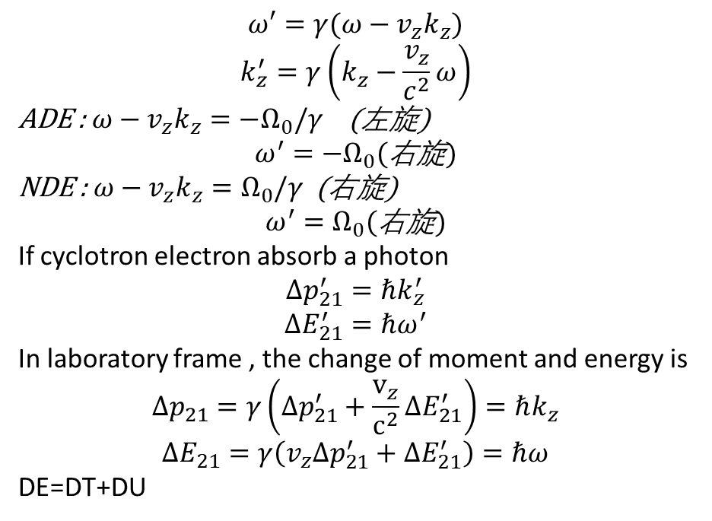
In Moving electron frame
Consider an electron moving with velocity v_{z}​ along the magnetic field in the z-direction with external E.M.wave (w,kz), in the electron's rest frame:
U₂
B_{Z}
$$φ$$
U₁
$$ω′=γ(ω−v_{z}k_{z})$$
$$k_{z}^{′}=γ\left(k_{z}−\frac{v_{z}}{c^{2}}ω\right)$$
ADE : $ω−v_{z}k_{z}=−Ω_{0}/γ$ (左旋)
$$ω^{′}=−Ω_{0}(\text{右旋})$$
NDE : $ω−v_{z}k_{z}=Ω_{0}/γ$ (右旋)
$$ω^{′}=Ω_{0}(\text{右旋})$$
If cyclotron electron absorb a photon
$$Δp_{21}^{′}=ℏk_{z}^{′}$$
$$ΔE_{21}^{′}=ℏω^{′}$$
In laboratory frame , the change of moment and energy is
$$Δp_{21}=γ\left(Δp_{21}^{′}+\frac{v_{z}}{c^{2}}ΔE_{21}^{′}\right)=ℏk_{z}$$
$$ΔE_{21}=γ\left(v_{z}Δp_{21}^{′}+ΔE_{21}^{′}\right)=ℏω$$
DE=DT+DU
$$v_{z2}$$
$$v_{z1}$$
$$v_{⊥2}$$
T₂
$$v_{⊥1}$$
T₁
$$ℏω$$
Both absorbing and emitting are possible
Notes:
$\left(k_{z}−\frac{v_{z}}{c^{2}}ω\right)$=$k\left(cos\left(θ\right)−cos\left(θ_{ξ}\right)\right),where cos\left(θ_{ξ}\right)=\frac{v_{z}}{cn}$<1

Slide 3
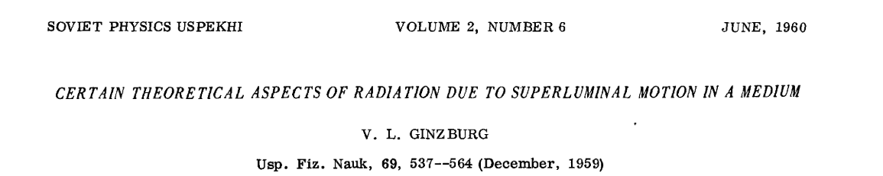
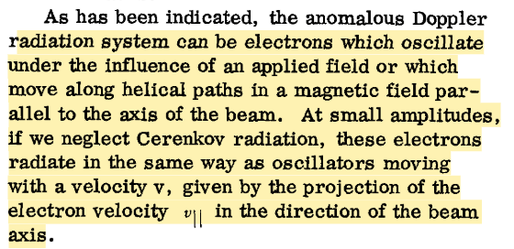
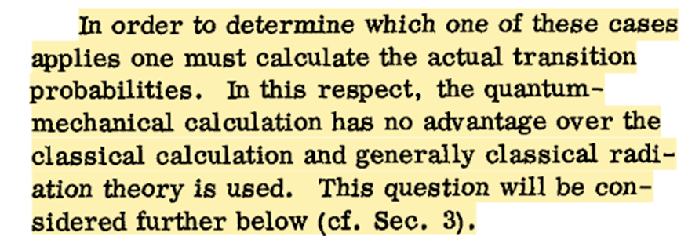

Slide 4

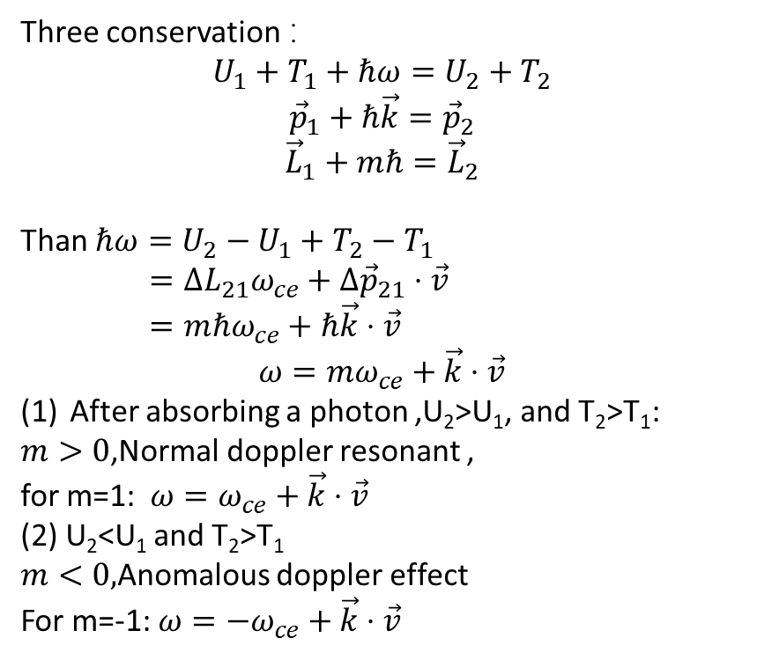
1. Absorbing photon process , (k // v$z$)
Laboratory frame
Three conservation ：
$$U_{1}+T_{1}+ℏω=U_{2}+T_{2}$$
$${\vec{p}}_{1}+ℏ\vec{k}={\vec{p}}_{2}$$
$${\vec{L}}_{1}+mℏ={\vec{L}}_{2}$$
Than $ℏω=U_{2}−U_{1}+T_{2}−T_{1}$
$=ΔL_{21}ω_{ce}+Δ{\vec{p}}_{21}⋅\vec{v}$
$=mℏω_{ce}+ℏ\vec{k}⋅\vec{v}$
$$ω=mω_{ce}+\vec{k}⋅\vec{v}$$
After absorbing a photon ,U₂>U₁, and T₂>T₁:
$m>0$,Normal doppler resonant ,
for m=1: $ω=ω_{ce}+\vec{k}⋅\vec{v}$
(2) U₂<U₁ and T₂>T₁
$m<0,$Anomalous doppler effect
For m=-1: $ω=−ω_{ce}+\vec{k}⋅\vec{v}$
U₂
B_{Z}
$$φ$$
U₁
$$v_{z2}$$
$$v_{z1}$$
$$v_{⊥2}$$
T₂
$$v_{⊥1}$$
T₁
+
$$ℏω$$

Slide 5

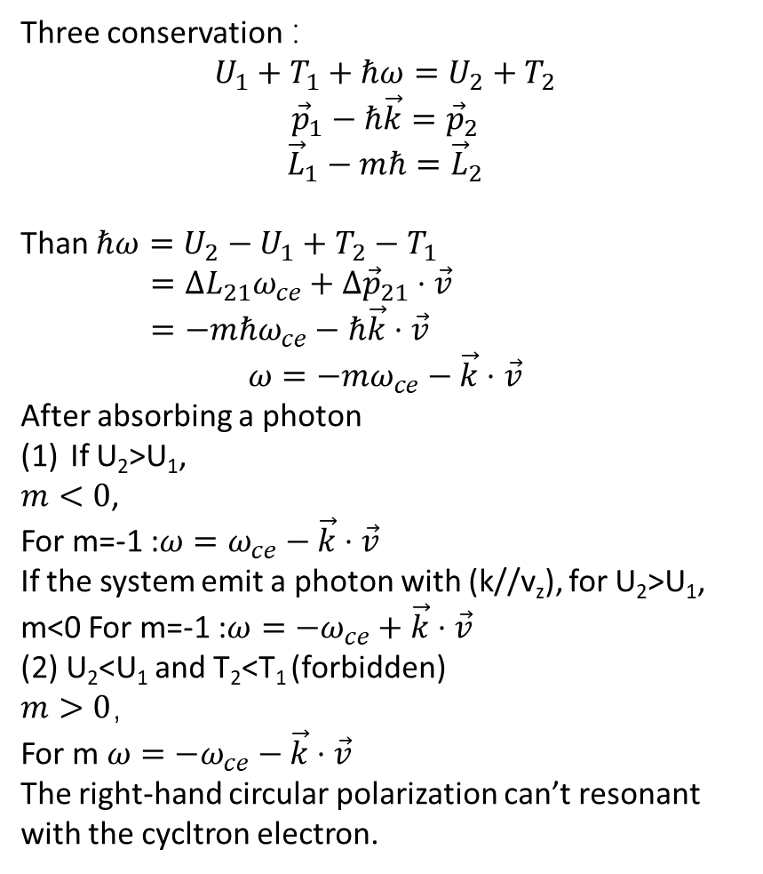
1. Absorbing photon process , (k // -v$z$)
Three conservation ：
$$U_{1}+T_{1}+ℏω=U_{2}+T_{2}$$
$${\vec{p}}_{1}−ℏ\vec{k}={\vec{p}}_{2}$$
$${\vec{L}}_{1}−mℏ={\vec{L}}_{2}$$
Than $ℏω=U_{2}−U_{1}+T_{2}−T_{1}$
$=ΔL_{21}ω_{ce}+Δ{\vec{p}}_{21}⋅\vec{v}$
$=−mℏω_{ce}−ℏ\vec{k}⋅\vec{v}$
$$ω=−mω_{ce}−\vec{k}⋅\vec{v}$$
After absorbing a photon
If U₂>U₁,
$m<0$,
For m=-1 :$ω=ω_{ce}−\vec{k}⋅\vec{v}$
If the system emit a photon with (k//v_{z}), for U₂>U₁, m<0 For m=-1 :$ω=−ω_{ce}+\vec{k}⋅\vec{v}$
(2) U₂<U₁ and T₂<T₁ (forbidden)
$m>0$，
For m $ω={−ω}_{ce}−\vec{k}⋅\vec{v}$
The right-hand circular polarization can’t resonant with the cycltron electron.
Laboratory frame
U₂
B_{Z}
$$φ$$
U₁
$$v_{z2}$$
$$v_{z1}$$
$$v_{⊥2}$$
T₂
$$v_{⊥1}$$
T₁
+
$$ℏω$$

Slide 6

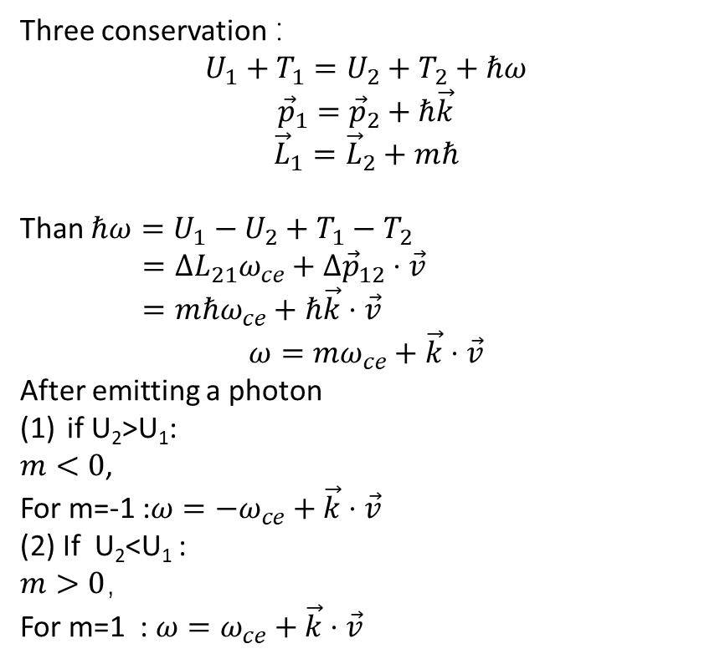
2. Emission photon process , (k // v$z$)
Laboratory frame
Three conservation ：
$$U_{1}+T_{1}=U_{2}+T_{2}+ℏω$$
$${\vec{p}}_{1}={\vec{p}}_{2}+ℏ\vec{k}$$
$${\vec{L}}_{1}={\vec{L}}_{2}+mℏ$$
Than $ℏω=U_{1}−U_{2}+T_{1}−T_{2}$
$=ΔL_{21}ω_{ce}+Δ{\vec{p}}_{12}⋅\vec{v}$
$=mℏω_{ce}+ℏ\vec{k}⋅\vec{v}$
$$ω=mω_{ce}+\vec{k}⋅\vec{v}$$
After emitting a photon
if U₂>U₁:
$m<0$,
For m=-1 :$ω={−ω}_{ce}+\vec{k}⋅\vec{v}$
(2) If U₂<U₁ :
$m>0$，
For m=1 : $ω=ω_{ce}+\vec{k}⋅\vec{v}$
U₂
B_{Z}
$$φ$$
U₁
$$v_{z2}$$
$$v_{z1}$$
$$v_{⊥2}$$
T₂
$$v_{⊥1}$$
T₁
+
$$ℏω$$

Slide 7
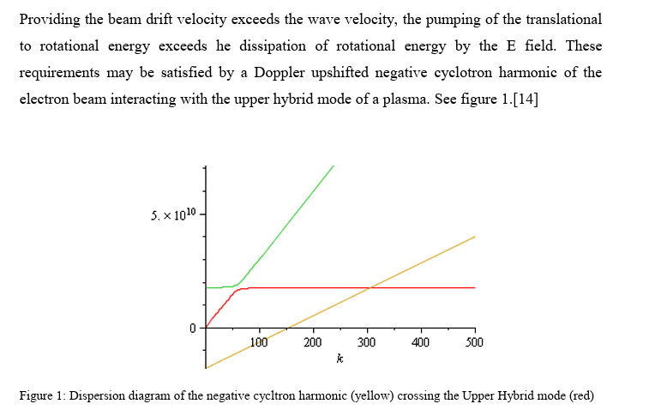
Numerical simulations of the anomalous Doppler resonance using 3D Particle-in-Cell code

Slide 8
(a)
(b)
(c)
air
Robert’s lens
Another focus lens

